Slide 1
Theater Simulation
Data 604 – Summer 2020
John Kellogg

Slide 2
Model Purpose
Model a theater for 90 minutes to judge correct staffing based on median wait times to enter theater movie theater room
90 minutes taking into account early arrival up to late arrivals
Example:
Movie starts at 17:00
Previews end at 17:20
Simulation would account for time from 15:50-17:20
Known stations each user will encounter
Cashier – Purchase ticket (Required)
Health Check Usher – Check temperature and ensure health form completed (Required)
Ticket Check Usher – Check User ticket (Required)
Concessions Server – purchase concessions (Optional)

Slide 3
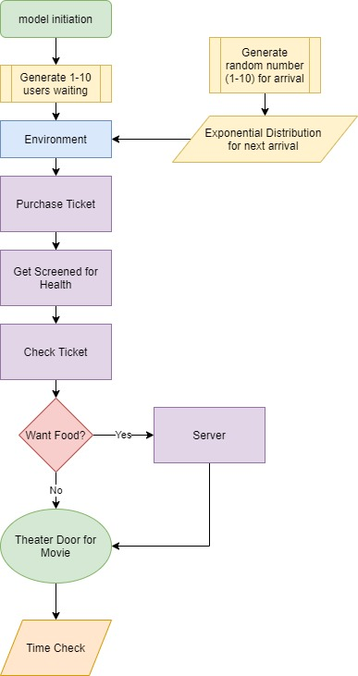
Theater Perspective Flowchart

Slide 4
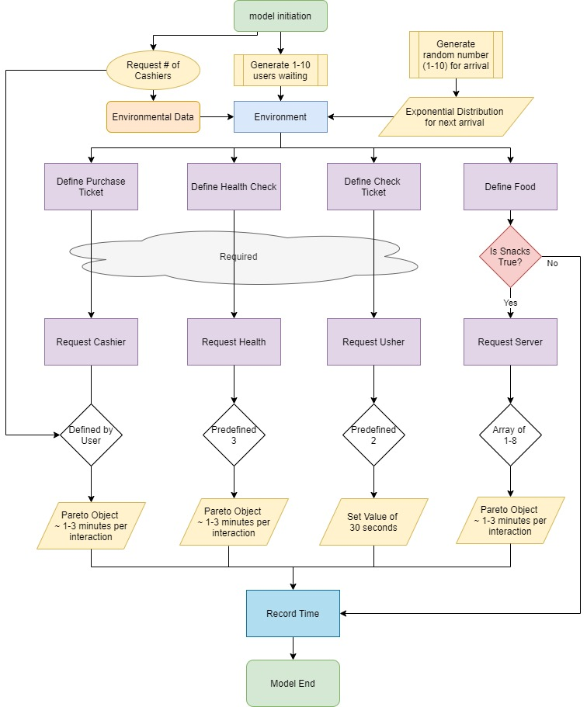
Simulation Flow Chart

Slide 5
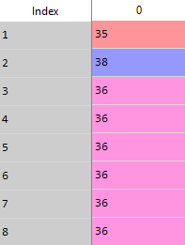
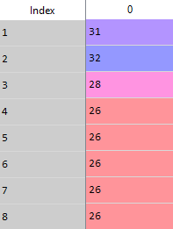
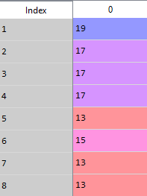
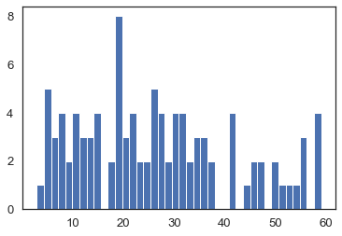
Arrival times
Analysis:
Model times are the same with 2 or 3 Cashiers
To keep costs low, Theater should use 2 cashiers
Optimal manpower: 4 servers, 2 cashiers
High flow manpower: 5-6 Servers, 4 Cashiers
1 Cashier
2 Cashier
# of Servers
3 Cashier
4 Cashier
# of Servers
Minutes

Slide 6
Questions
2 versions available
Full input for all staff (.py file)
Sweep Series model (Notebook file)
https://github.com/kelloggjohnd/Data604.git
Theater_sim.html
Parts of code borrowed from:
https://realpython.com/simpy-simulating-with-python/
My Python programming chops are not as good as they should be ☺

